Slide 2
DrupalCon Austin
The largest event in the world to learn Drupal skills and network with the community
A concentration of training and expertise found nowhere else
An investment in Drupal talent and relationships

Slide 3
Who comes to DrupalCon?
“
I love going to DrupalCon. It’s a fantastic, well-run, affordable conference with a high-quality, jam-packed program.
- Grant Kruger, Software Engineer at Meyer Memorial Trust
Our team attended DrupalCon for the great training sessions and to learn about best practices for our large scale Drupal installation. DrupalCon is a fantastic way to grow skills and network with the community.
-Thomas Jones, University of Minnesota Bookstore
I am new to Drupal. Attending DrupalCon and having the opportunity to meet and work with other Drupal enthusiasts in person was invaluable to me.
-Chris Corbett, Web Developer at Walsh University
”

Slide 4
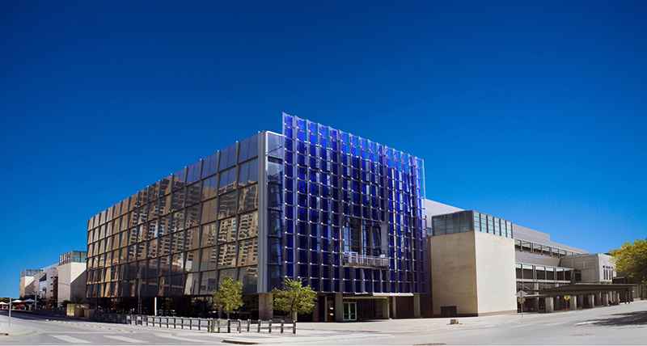
Austin Convention Center

Slide 5
Important Dates
April 1- Drupal Training courses published, selected sessions published, last day to sign up as a sponsor
April 4 - Earlybird ticket pricing ends
April 15 - Grant and Scholarship recipients announced. Full conference schedule published
May 2 - Regular ticket pricing ends. Save $75 on training offer ends
May 16 - Last day to request a letter of invitation
May 26 - Last day to submit payment for all unpaid/pending invoices
May 30 - Late ticket pricing ends
June 1 - Onsite registration opens
June 2-6 - DrupalCon Austin

Slide 6
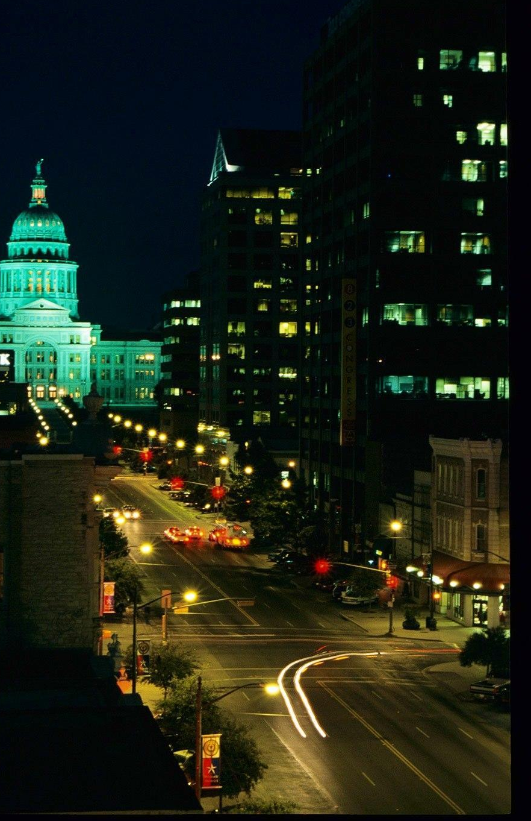
Learning & Sharing…
100+ Sessions
7 Professional Drupal Trainings
70+ BOFs

Slide 7
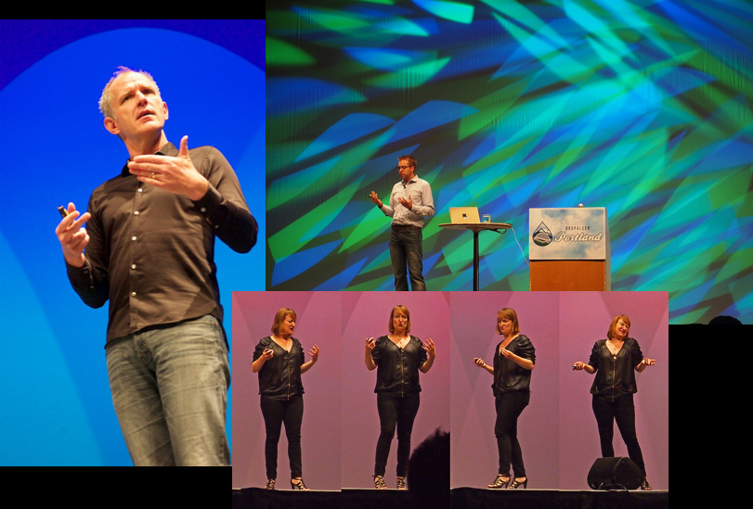
Top-Notch Key Note Speakers

Slide 8
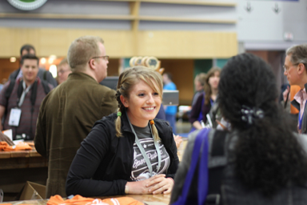
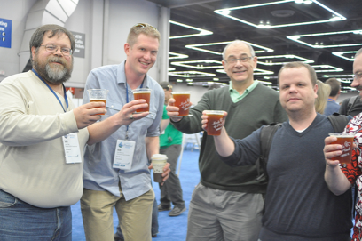
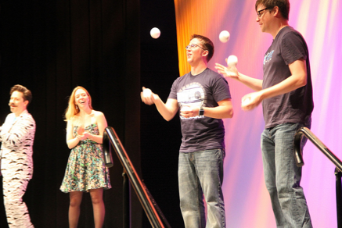
Networking and Fun

Slide 9
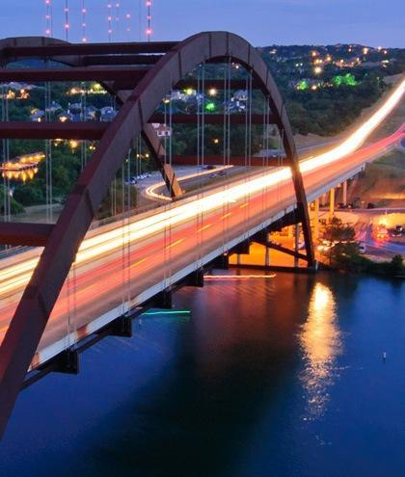
Gorgeous Vacation Location

Slide 10
Helpful Information
Ticket and Registration: https://austin2014.drupal.org/tickets
Important Dates: https://austin2014.drupal.org/important-dates
Accommodations: https://austin2014.drupal.org/travel#hotel
Venue: https://austin2014.drupal.org/venue
Spread the Word: https://austin2014.drupal.org/spread-the-word
Sponsors: https://austin2014.drupal.org/sponsors

Slide 11
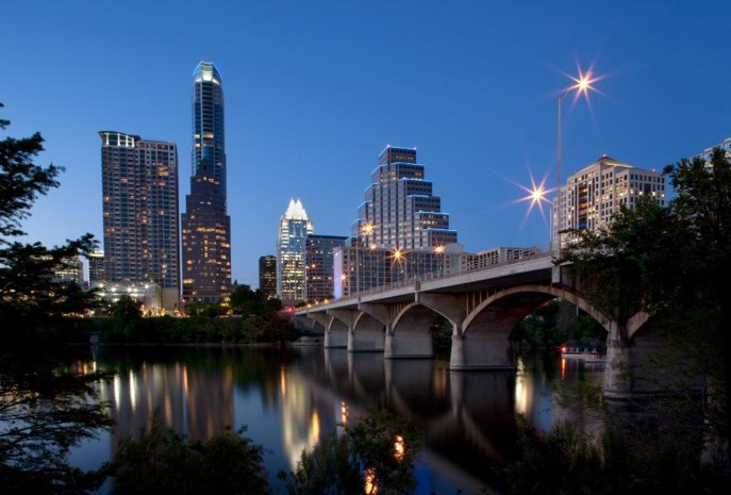
Join us in Austin this June!
https://austin2014.drupal.org/

Slide 12
